Slide 1
Civic Tech and LoRaWAN Hackathon for a better city

Slide 2
Thank you!
Make Zurich Vol. II

Slide 3
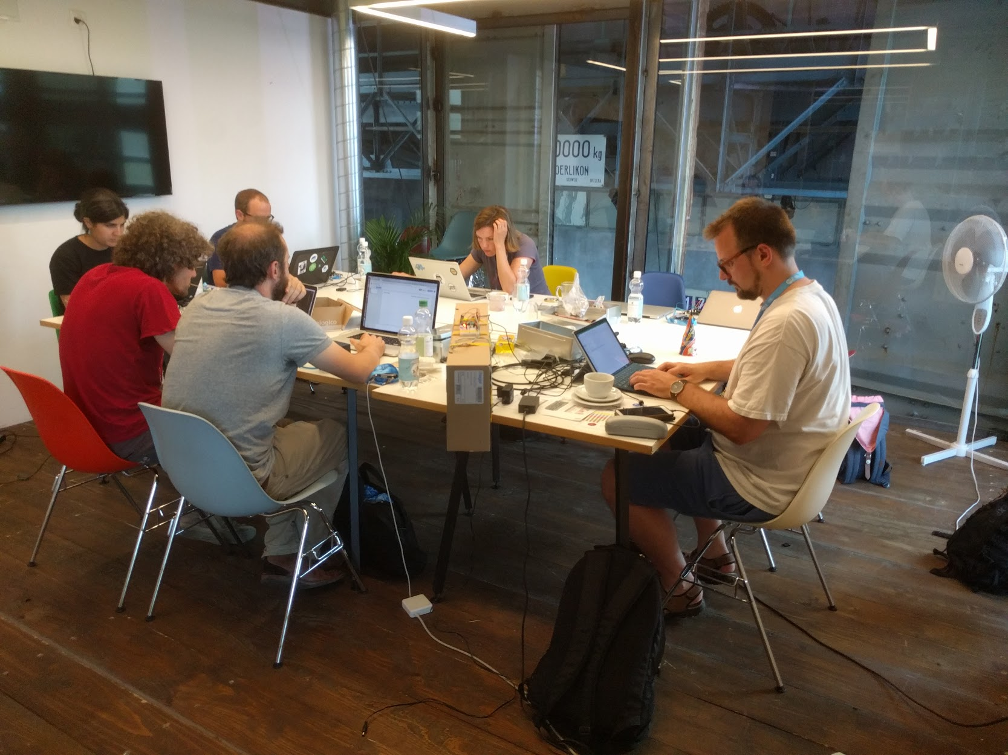
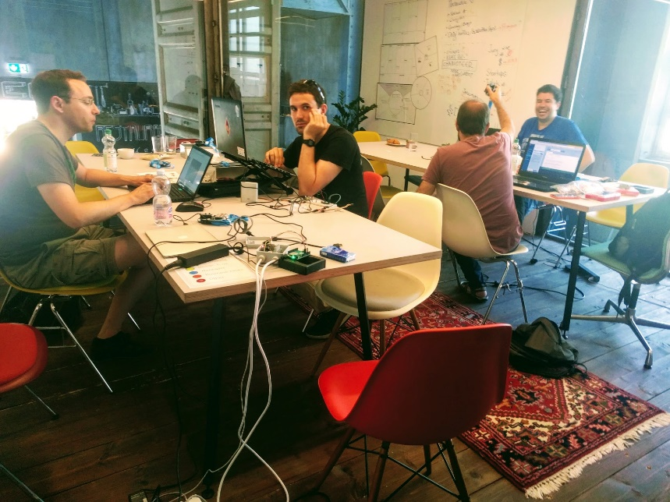
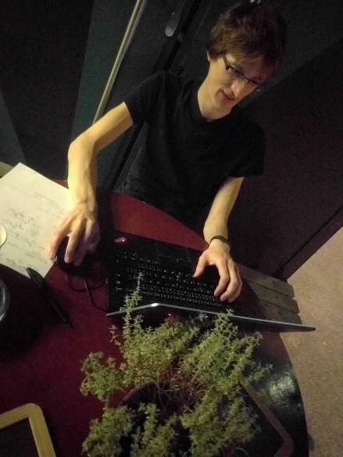
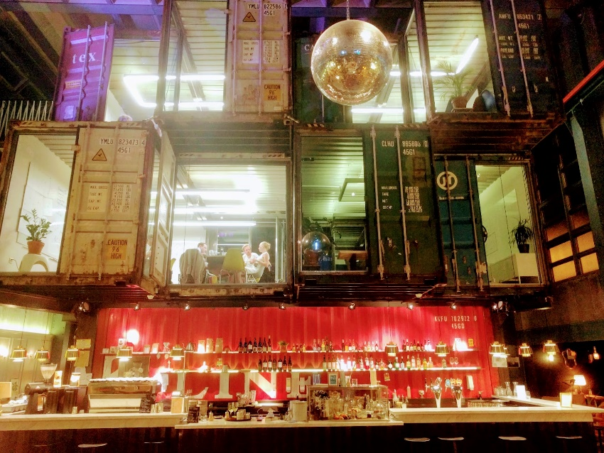
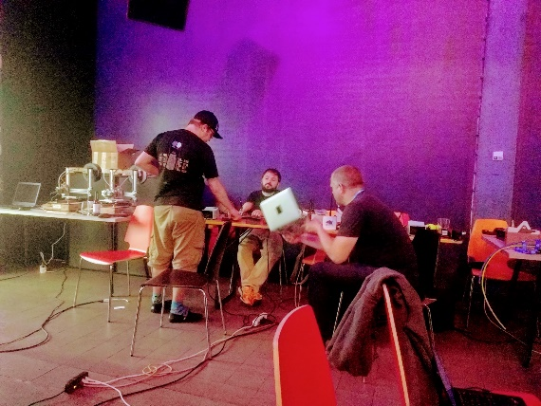
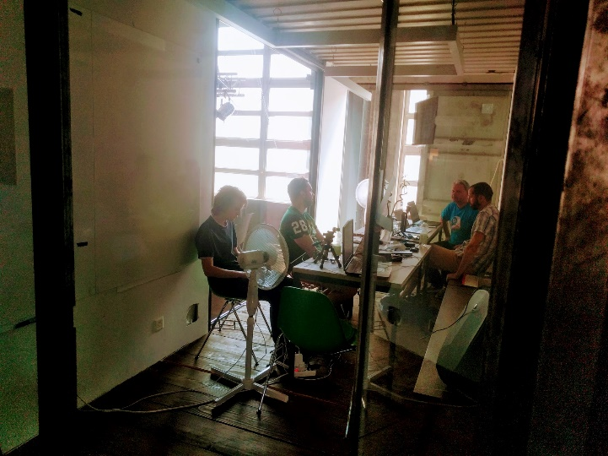
All participants!
THANK YOU!

Slide 4
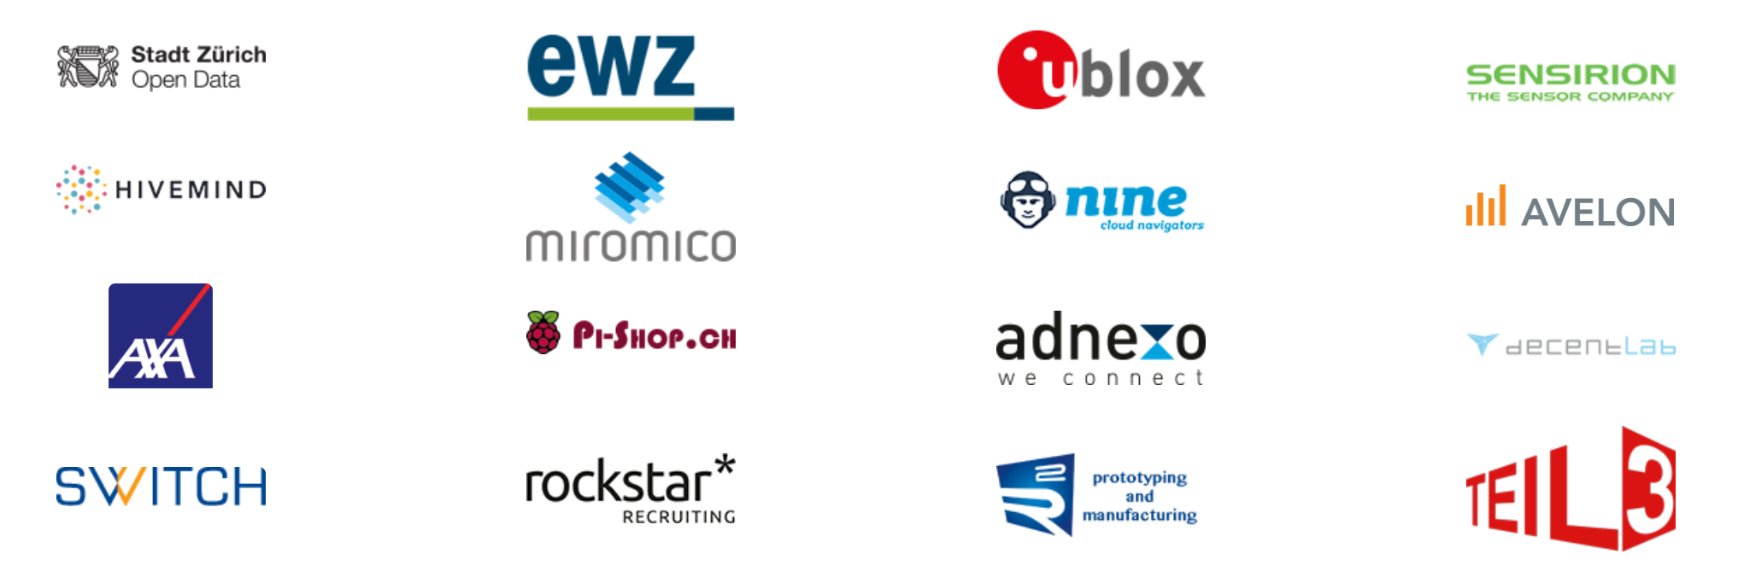
Sponsors and partners
THANK YOU!

Slide 5

Community partners
THANK YOU!

Slide 6
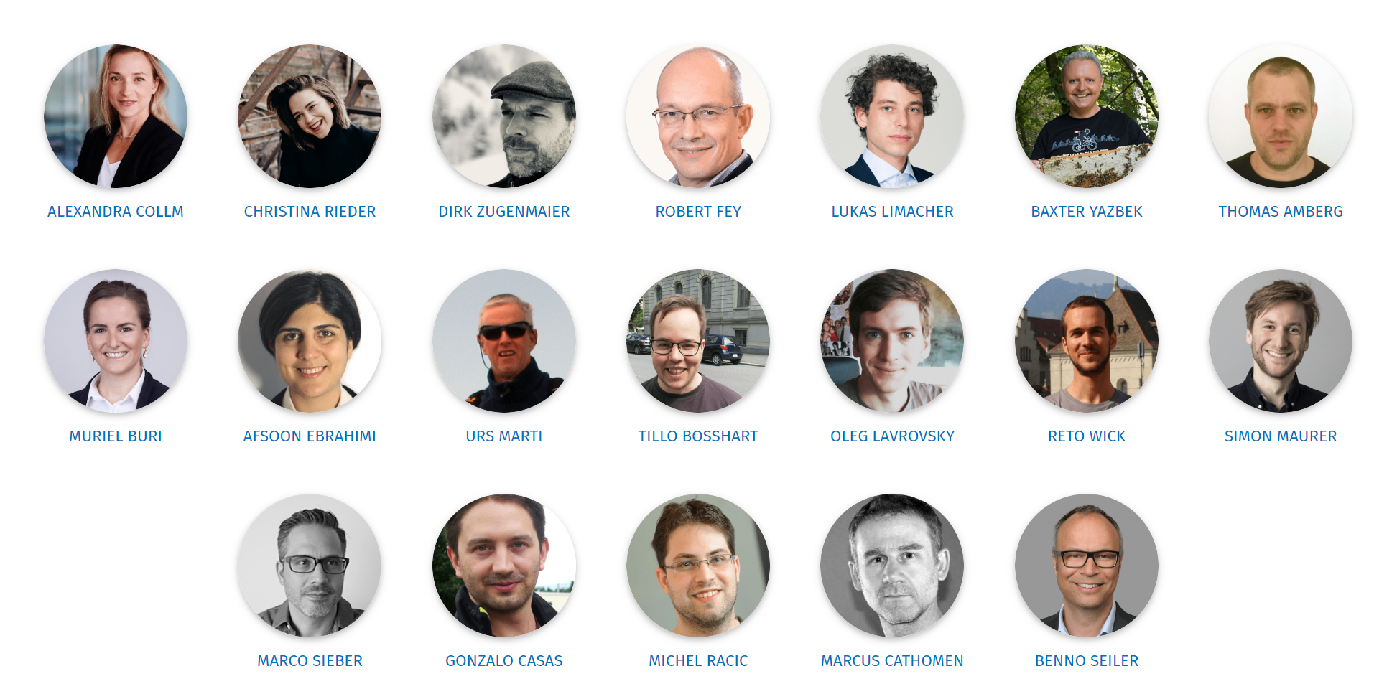
Organization TEAM
THANK YOU!

Slide 7
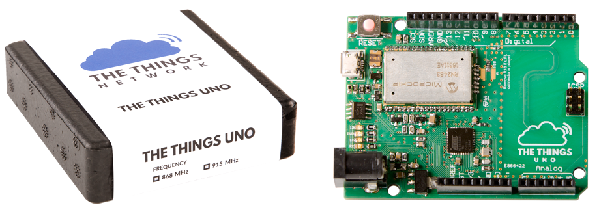
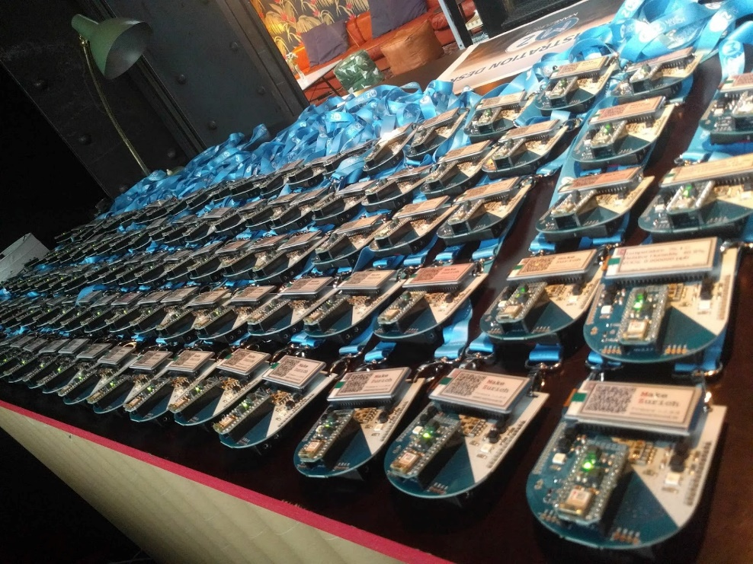
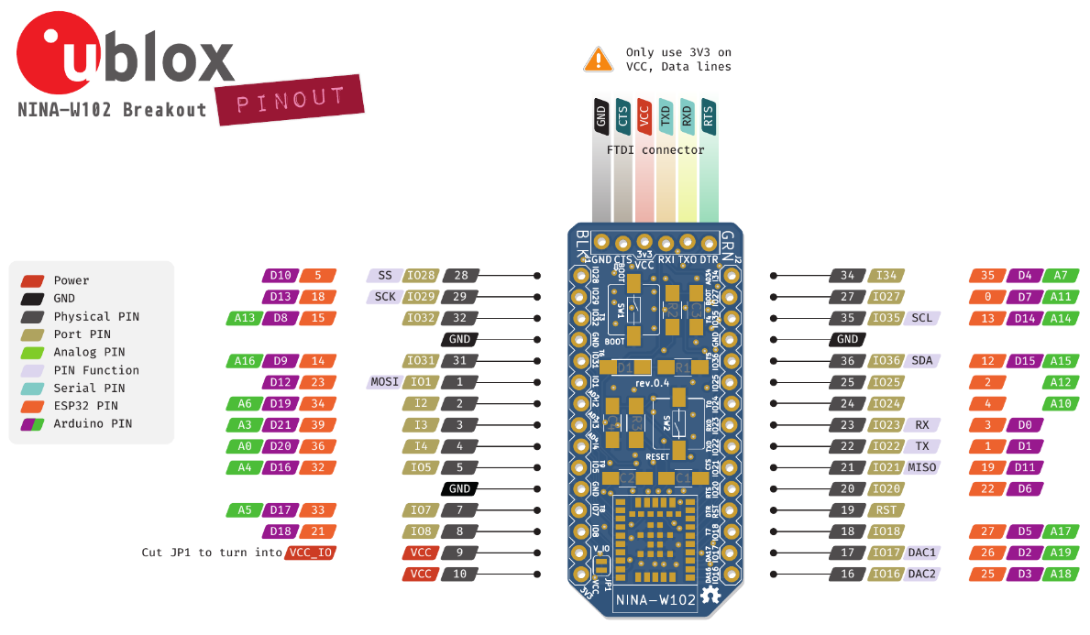
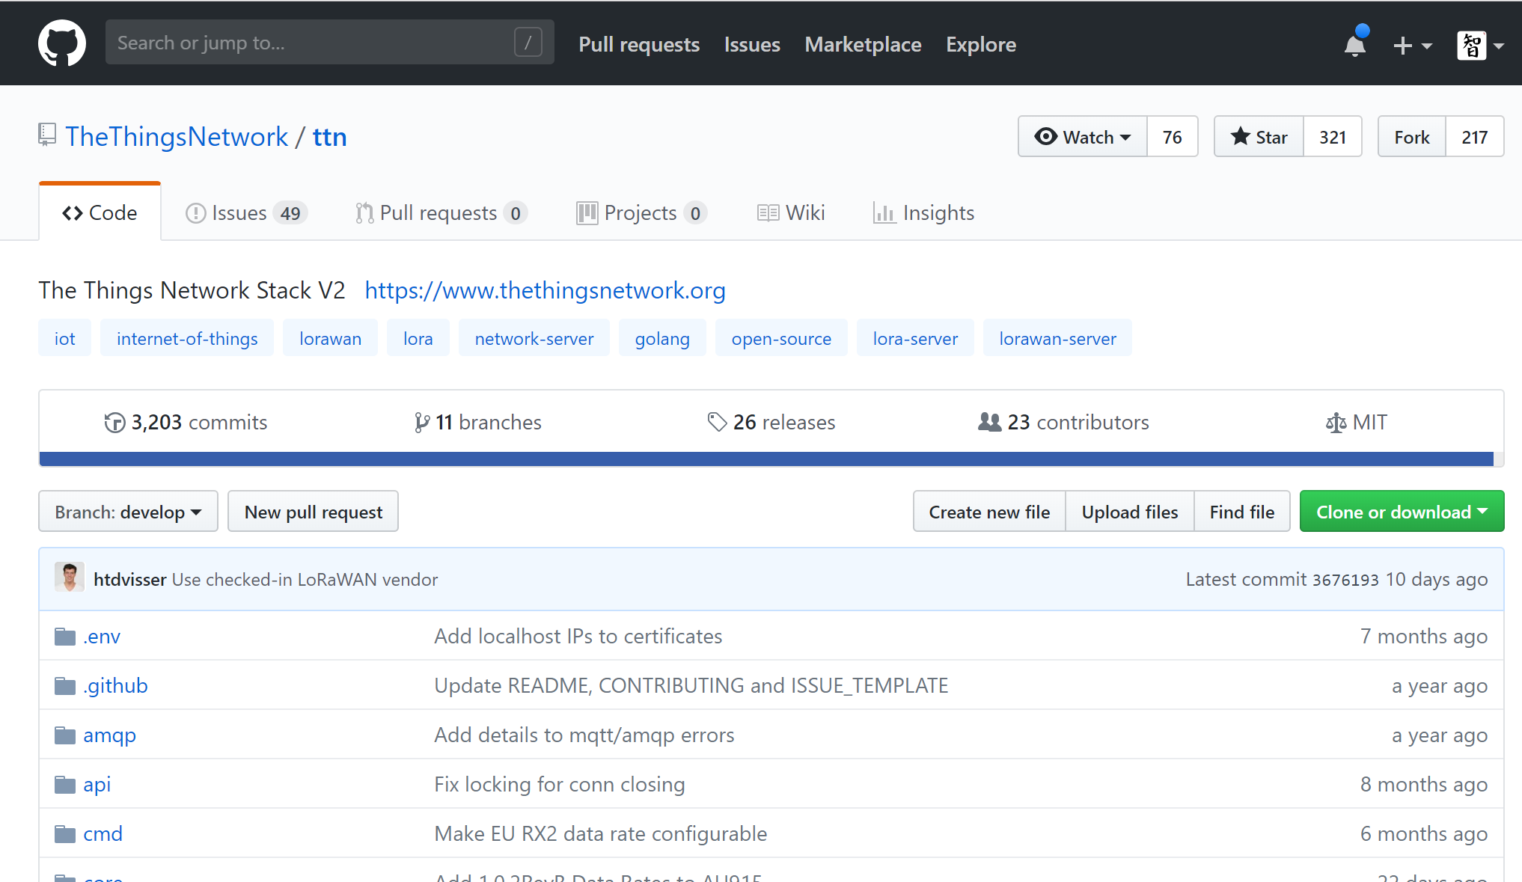
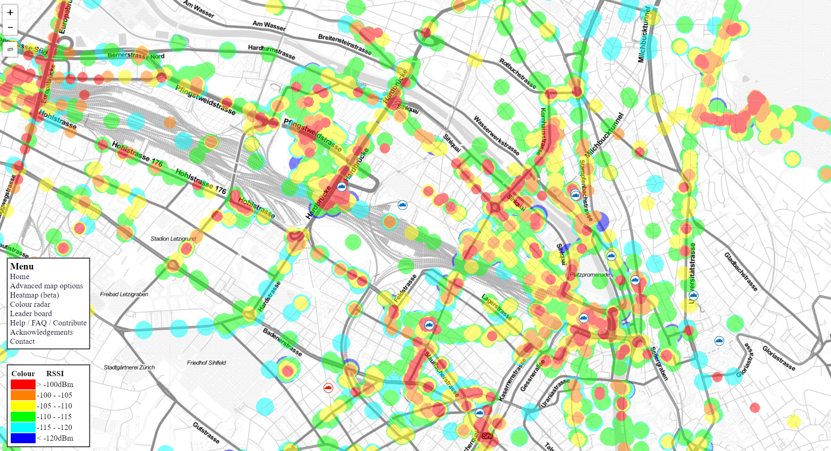
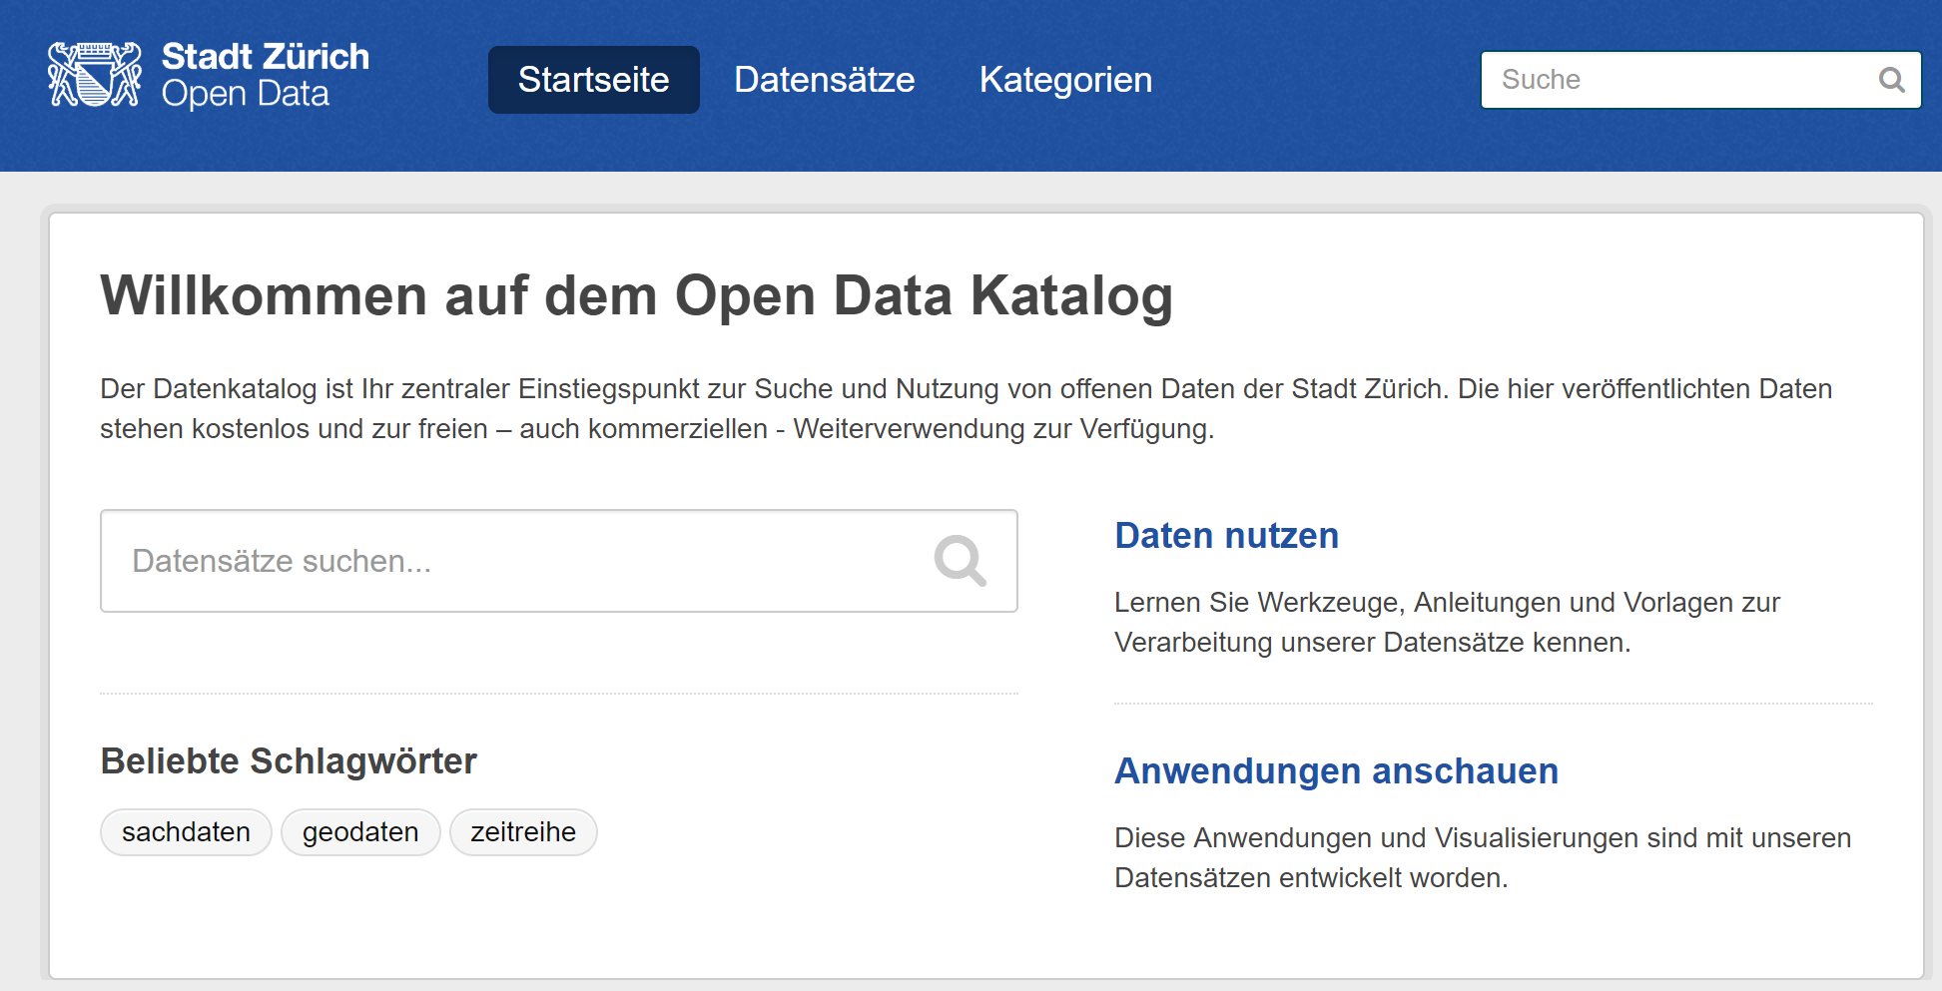
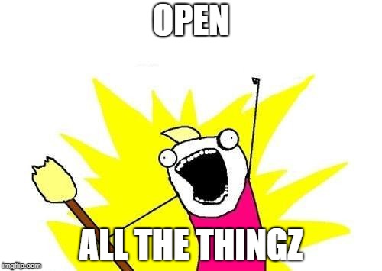
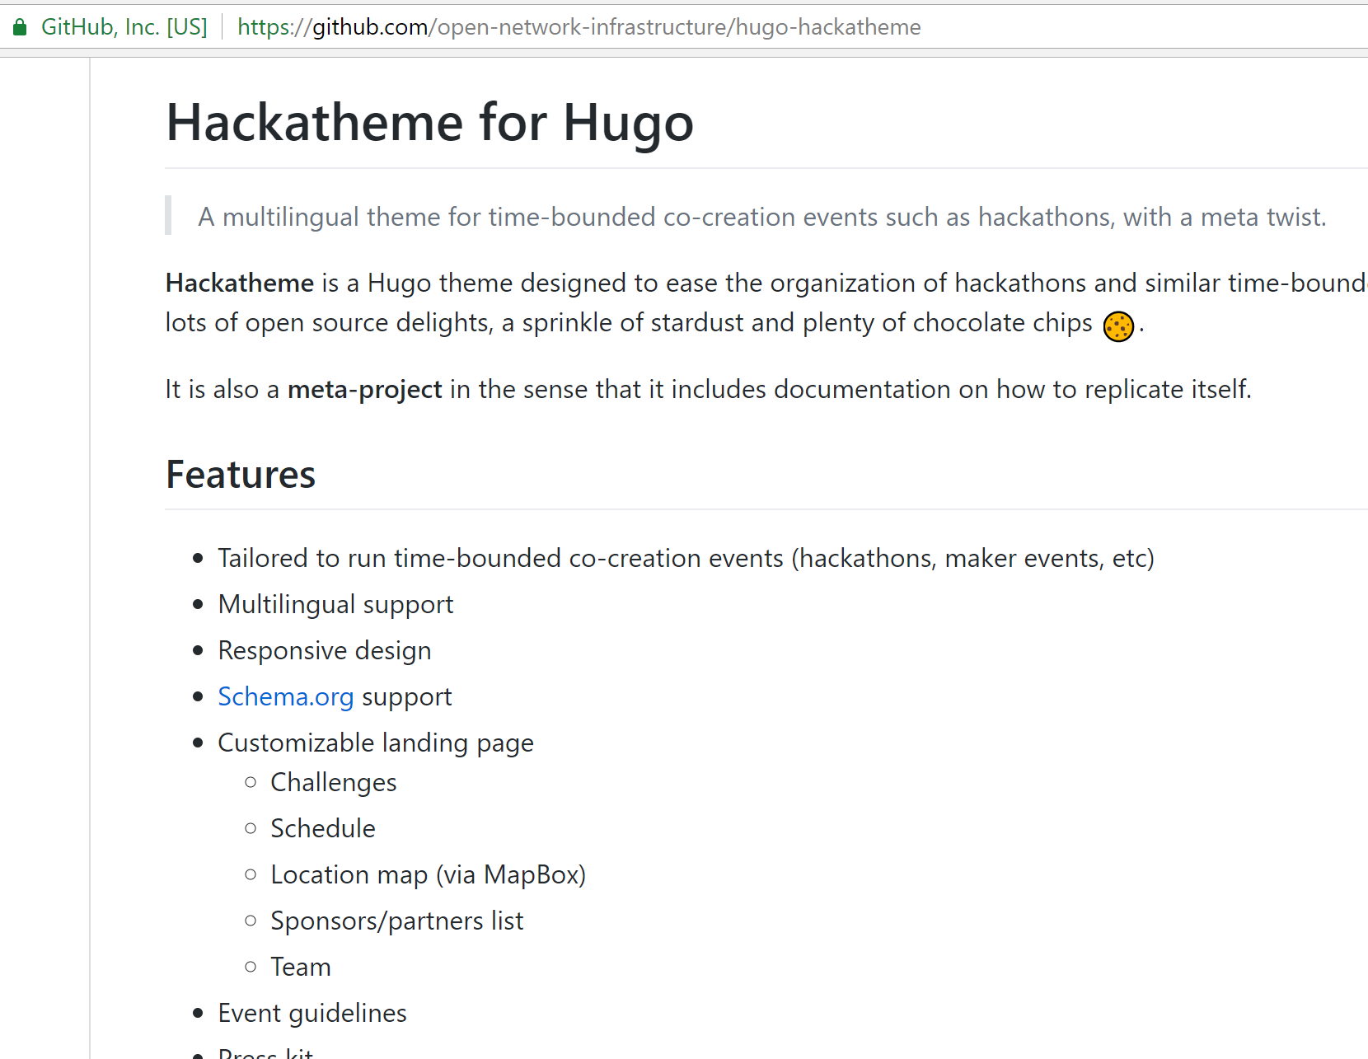
Openness

Slide 8
Introduction to ONIA
What is the Open Network Infrastructure Association?

Slide 10
What do we do?
Underpins The Things Network Switzerland („Trägerverein“)
Runs a Swiss TTN backend together with SWITCH
Represents TTN Switzerland at TTN Global
Organizes events such as #MakeZurich and workshops
Lobbies for free and open decentralized network infrastructure in Switzerland (→ more members, more influence!)

Slide 11
Recipient of the DINACON open internet Award 2017

Slide 12
opennetworkinfrastructure.org/join
Join!

Slide 13
Team Presentations

Slide 14
Projects
EasyBus
Realtime Occupancy Rate
One Planet
Upcycling O-Bikes
No Bike Left Behind
Blackout Reader
pakman
Forest People
Forest Sound Track
InterCat
Charioteer
PLEASE DOCUMENT YOUR PROJECT!
PLAN TO WORK ON IT FURTHER?

Slide 15
Upcoming events
Like-minded hackathons in temporal proximity

Slide 16

TWIST 2018: August 25-26
twist2018.ch

Slide 17

Open Food Hackdays: 7-9 September

Slide 18

Open GLAM: October 26-28
glam.opendata.ch

Slide 19
SEE YOU NEXT TIME!

Slide 20
THANK YOU!

